Slide 1



NOIDA INSTITUTE OF ENGINEERING AND TECHNOLOGY, GREATER NOIDA
Solar energy systems
UNIT - 2
RER (KOE-074)
Vikas kumar
ME Deptt.
B.Tech IV, CSE- VII Sem
6/22/2022
1

Slide 2

FACULTY INTRODUCTION
Faculty Details:
Name of Faculty: Mr. Vikas Kumar
Higher Education : M.Tech (Mechanical Engineering)
Department: Department of Mechanical Engineering
Faculty Id: Vikaskumar.me@niet.co.in
Subjects: Fluid Mechanics & Machine
Applied Thermodynamics
Hybrid Vehicle Propulsion
Simulation , Modeling & Analysis
Basics of DBMS

Slide 3


CONTENTS
Energy and Development
Energy demand and availability
Energy crisis
Conventional and Nonconventional energy
Renewable and Non-renewable energy resources
Environmental impacts of conventional energy usage
Basic concepts of heat and fluid flow useful for energy systems

Slide 4
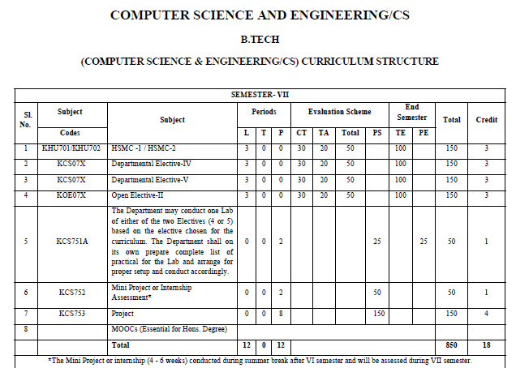
EVALUATION SCHEME

Slide 5
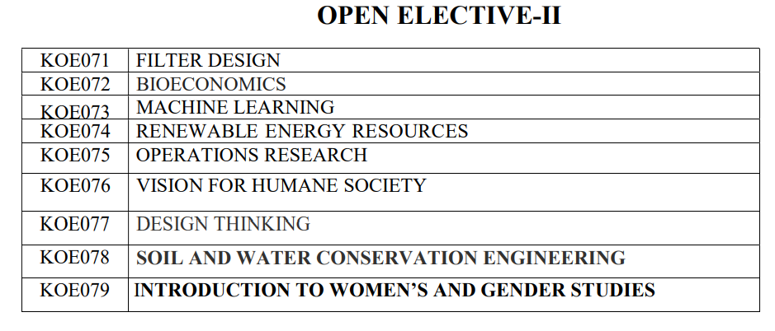
EVALUATION SCHEME

Slide 6













Course Objectives
.
To understand the need of energy conversion and the various renewable energy resources
CO 1
To impart the knowledge of solar energy and apply different method of solar energy
CO 2
To impart the knowledge of hydro power and utilize it on small scale.
CO 3
To Explain bio gas generation and its impact on environment
CO 4
To apply Winds energy as alternate form of energy and to know how it can be trapped
CO 5

Slide 7

CO-PO and PSO Mapping
CO | PO1 | PO2 | PO3 | PO4 | PO5 | PO6 | PO7 | PO8 | PO9 | PO10 | PO11 | PO12 | PSO1 | PSO2 | PSO3
CO1 | 3 | 3 | 2 | 2 | - | - | 2 | - | 2 | - | - | 3 | 3 | 2 | 3
CO2 | 3 | 3 | 2 | 2 | - | 2 | 2 | - | 2 | 2 | - | 3 | 3 | 3 | 3
CO3 | 3 | 3 | 2 | - | 2 | 3 | 3 | 2 | 2 | 2 | - | 3 | 2 | 3 | 3
CO4 | 3 | 3 | 2 | 3 | 2 | 2 | 2 | 2 | 2 | - | - | 3 | 3 | 3 | 3
CO5 | 2 | 2 | 2 | - | 2 | - | 3 | - | 2 | 2 | - | 3 | 3 | 3 | 3
Avg | 3 | 3 | 2 | 2 | 1 | 2 | 2 | 1 | 2 | 1 | - | 3 | 2.67 | 3 | 3

Slide 8
Syllabus
Unit-I: Introduction: Various non-conventional energy resources- Introduction, availability, classification, relative merits and demerits. Solar Cells: Theory of solar cells. Solar cell materials, solar cell array, solar cell power plant, limitations.
Unit-II: Solar Thermal Energy: Solar radiation, flat plate collectors and their materials, applications and performance, focusing of collectors and their materials, applications and performance; solar thermal power plants, thermal energy storage for solar heating and cooling, limitations.
CO1

Slide 9
Syllabus
Unit-III: Geothermal Energy: Resources of geothermal energy, thermodynamics of geo- thermal energy conversion-electrical conversion, non-electrical conversion, environmental considerations. Magneto-hydrodynamics (MHD): Principle of working of MHD Power plant, performance and limitations. Cells: Principle of working of various types of fuel cells and their working, performance and limitations.
CO1

Slide 10
Syllabus
Unit-IV: Thermo-electrical and thermionic Conversions: Principle of working, performance and limitations. Wind Energy: Wind power and its sources, site selection, criterion, momentum theory, classification of rotors, concentrations and augments, wind characteristics. Performance and limitations of energy conversion systems.
Unit-V: Bio-mass: Availability of bio-mass and its conversion theory. Ocean Thermal Energy Conversion (OTEC): Availability, theory and working principle, performance and limitations. Wave and Tidal Wave: Principle of working, performance and limitations. Waste Recycling Plants.
CO1

Slide 11
Course Outcomes
Understand and utilize different renewable sources of energy
CO1
Utilize the knowledge of solar energy and apply different method of solar energy
CO2
Understand the procedure and application of micro and small hydro energy system.
CO3
Utilize bio mass energy and understand the process of bio gas generation
CO4
Understand the advantage and disadvantage of Wind energy.
CO5

Slide 12
COURSE APPLICATION
Application of Renewable Energy System:
Renewable Energy
Type | Application
Solar | Household Appliance, Water Heating
Biomass | Heat Energy
Wind | Power Generation
Biogas | Cooking

Slide 13



Unit Objective
To explain solar energy system and utilization in current era.

Slide 14


Objective of Topic
Topic: Solar energy system
Objective of Topic: To explain solar energy and its utilization

Slide 15
Prerequisite And Recap
Topic: solar energy system
Prerequisite : basic of renewable energy
Recap: different types of energy system

Slide 16
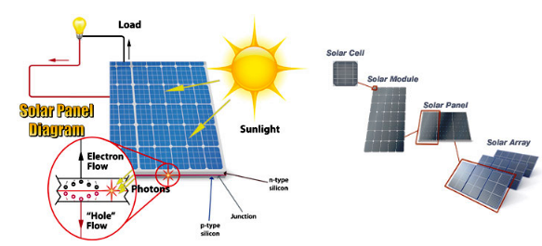
Solar power(CO2)
Solar power is the conversion of energy from sunlight into electricity, either directly using photovoltaic (PV), indirectly using concentrated solar power, or a combination.
Concentrated solar power systems use lenses or mirrors and solar tracking systems to focus a large area of sunlight into a small beam.

Slide 17
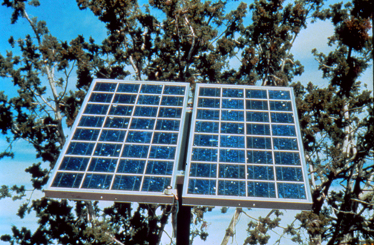
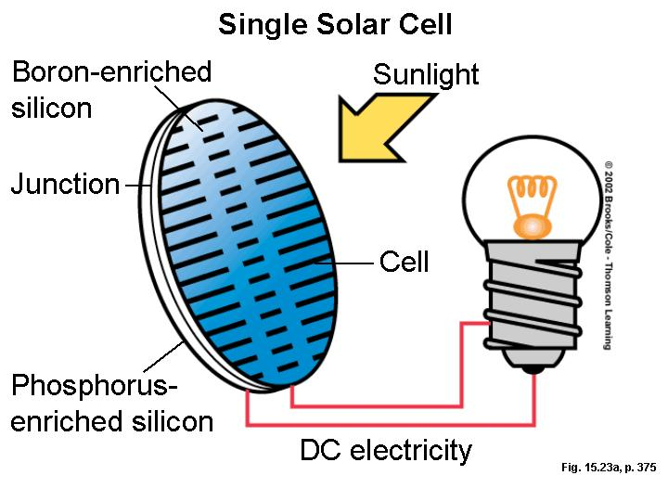
Photovoltaic(CO2)
.
Photo+voltaic = convert light to electricity

Slide 18
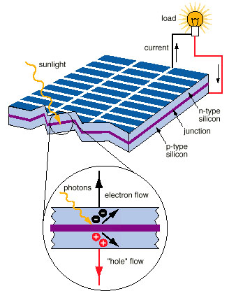
How Solar PV Cells Work(CO2)
.
Photons in sunlight hit the solar panel and are absorbed by semiconducting materials.
Electrons (negatively charged) are knocked loose from their atoms, allowing them to flow through the material to produce electricity.

Slide 19
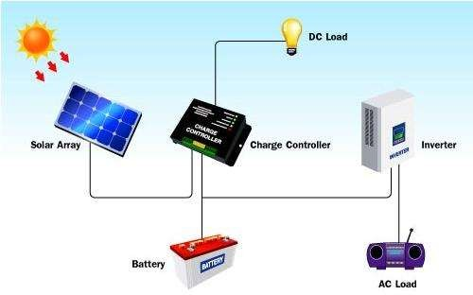
Components of solar PV system(cont..)

Slide 20
Solar Radiation(CO2)
Solar radiation is radiant energy emitted by the sun, particularly electromagnetic energy.
About half of the radiation is in the visible short-wave part of the electromagnetic spectrum.
The other half is mostly in the near-infrared part, with some in the ultraviolet part of the spectrum
Solar constant is defined, commonly taken as 1353 W/m2 , though there are some variations in the estimates..
11

Slide 21









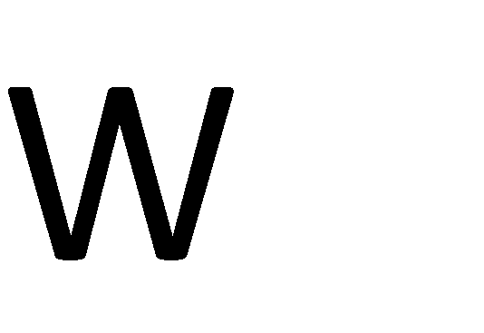


Calculation of solar energy(CO2)
Calculate the energy received by earth from sun and compare the energy received from sun, with the energy usage by humankind.

Slide 22

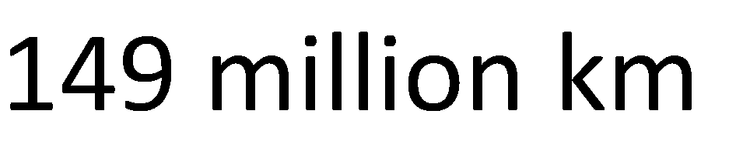


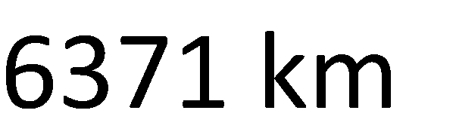
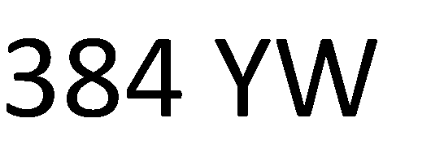

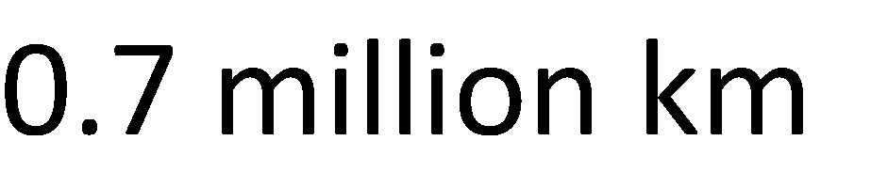
Calculation of solar energy(cont..)
.

Slide 23
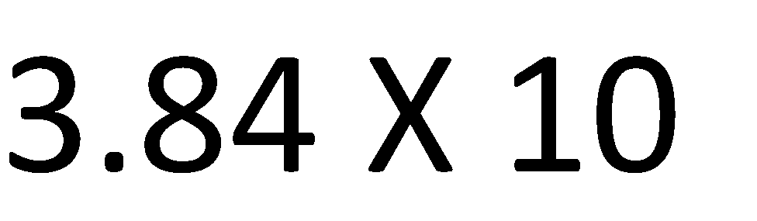
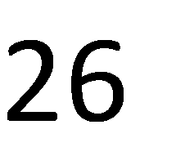
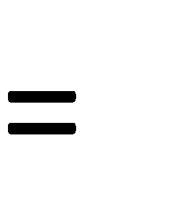
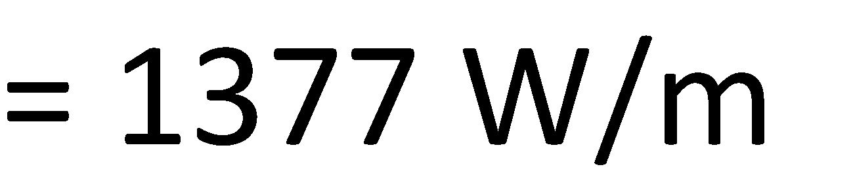

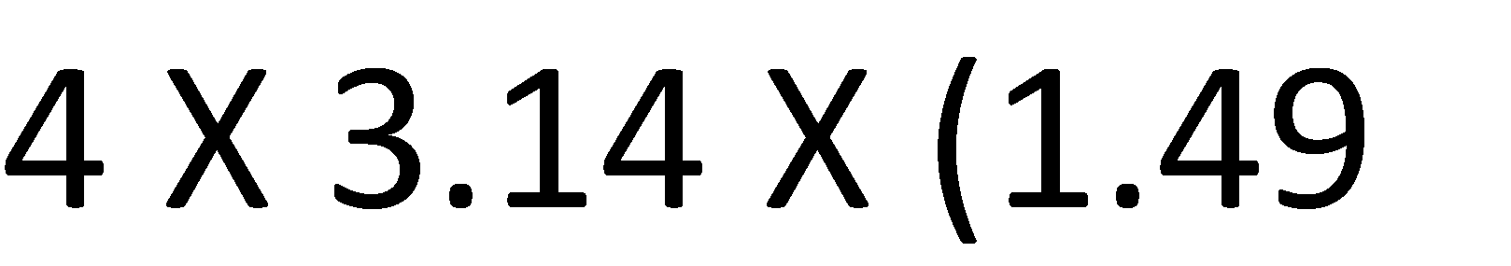



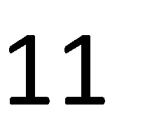

Intensity of sun’s radiation(CO2)
.
11

Slide 24

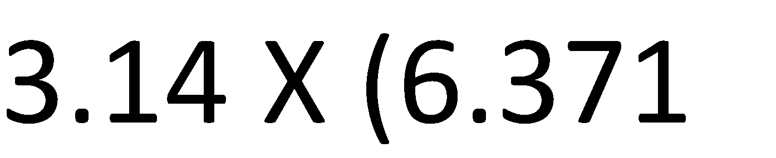



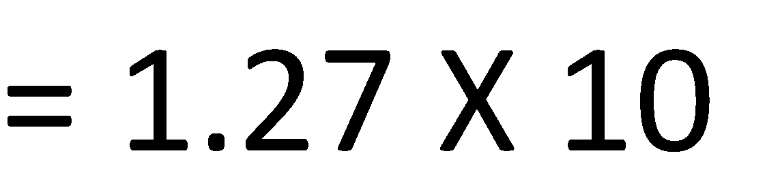
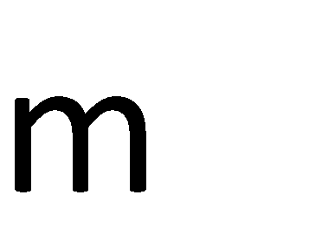
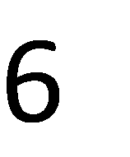

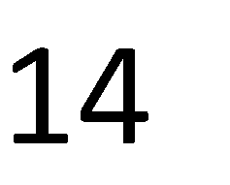

Area of earth disc(CO2)
.

Slide 25

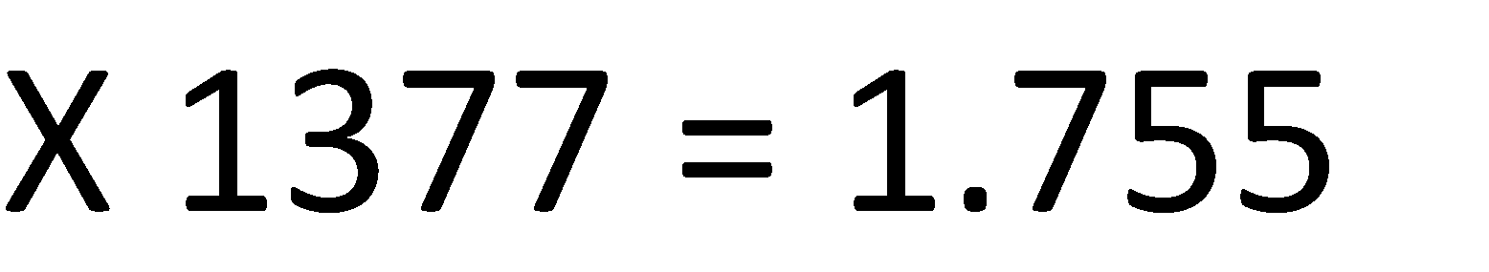

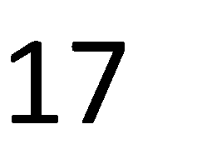

Power received from the sun(CO2)
.

Slide 26
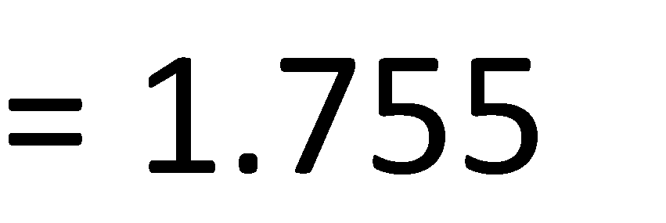

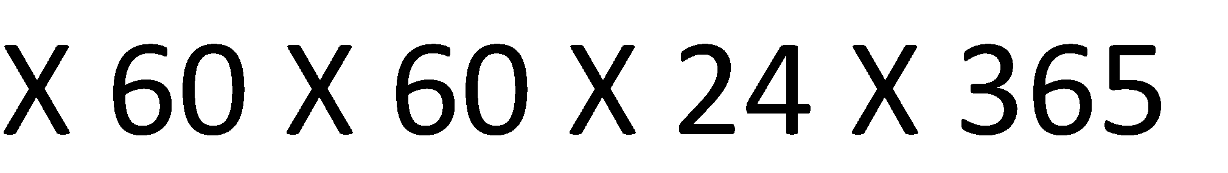
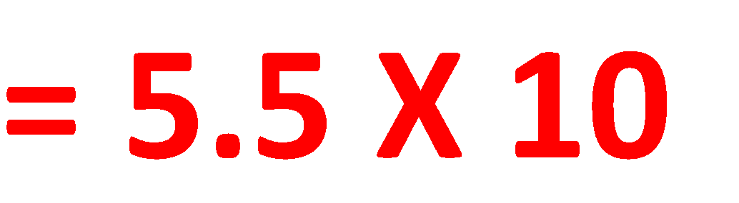


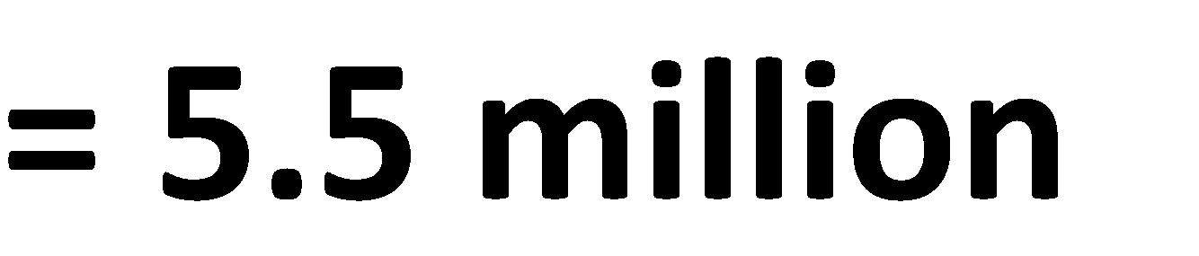


Energy received from the sun(CO2)
.
11

Slide 27


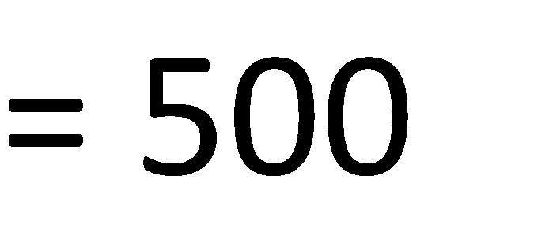


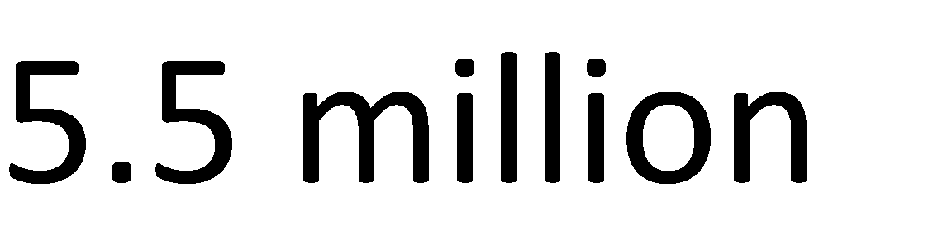



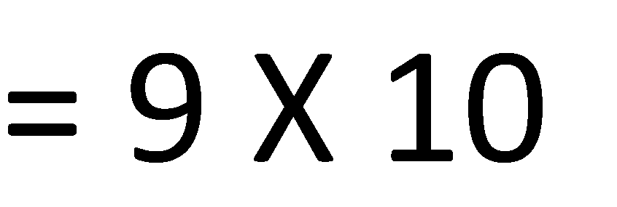




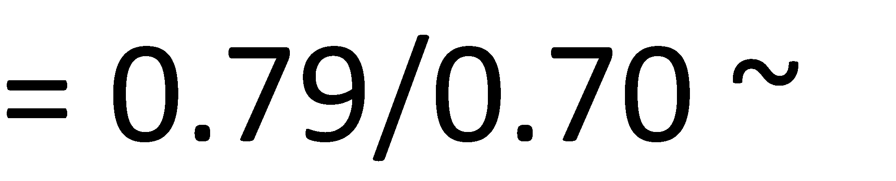

Energy usage(CO2)
.
Vikas kumar

Slide 28
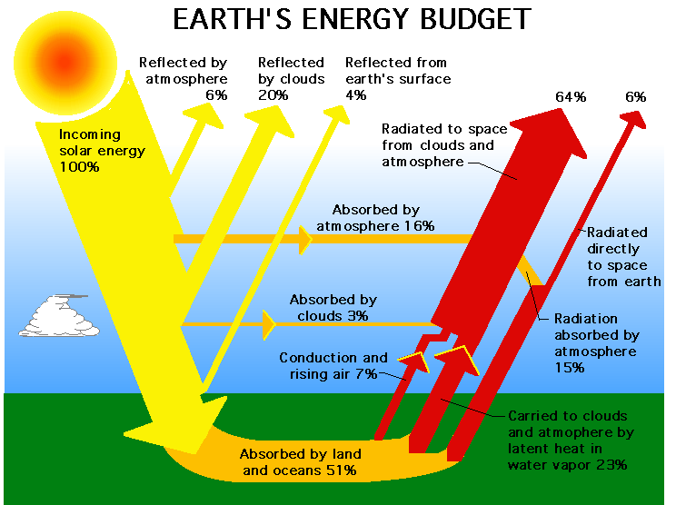
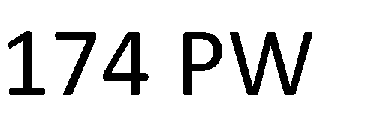
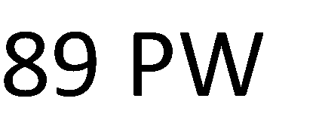

Solar budget(CO2)
.

Slide 29
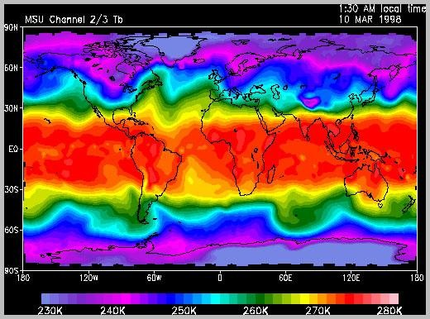
Solar budget(cont…)
.
Vikas kumar
(AMTME0113)

Slide 30





Solar spectrum(CO2)
.

Slide 31



















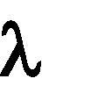
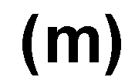

Black body radiation(CO2)
.

Slide 32
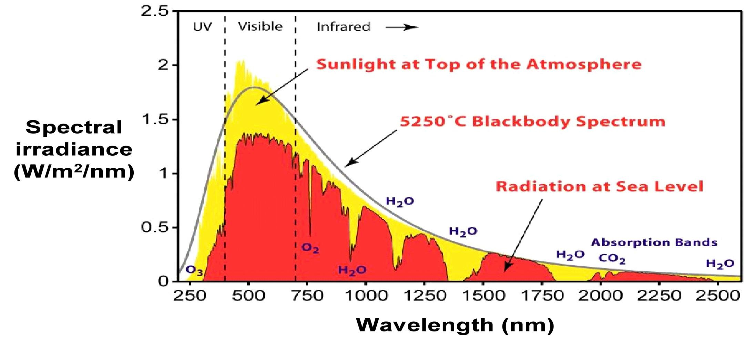
Black body radiation(cont..)
.

Slide 33
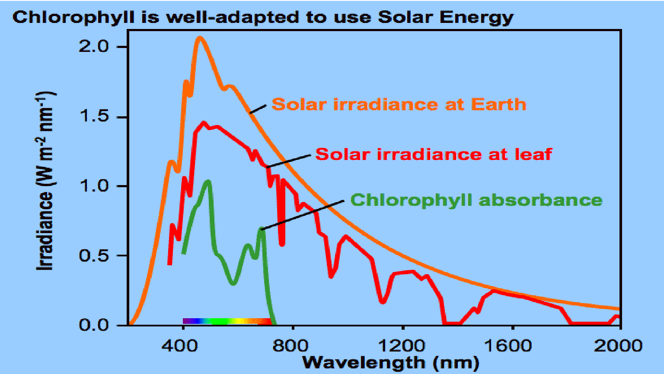
Black body radiation(CO2)
.

Slide 34
Solar Collectors (CO2)
Solar collectors transform solar radiation into heat and transfer that heat to a medium (water, solar fluid, or air).
Then solar heat can be used for heating water, to back up heating systems or for heating swimming pools.
A solar collector is basically a flat box and are composed of three main parts, a transparent cover, tubes which carry a coolant and an insulated back plate.
The solar collector works on the green house effect principle; solar radiation incident upon the transparent surface of the solar collector is transmitted through though this surface.
.

Slide 35
Solar Collectors (CO2)
The inside of the solar collector is usually evacuated, the energy contained within the solar collect is basically trapped and thus heats the coolant contained within the tubes.
The tubes are usually made from copper, and the back plate is painted black to help absorb solar radiation.
The solar collector is usually insulated to avoid heat losses.
.

Slide 36
Types of collectors(CO2)
• Stationary
• Sun tracking Applications
• Solar water heating
• Solar space heating and cooling
• Refrigeration
• Industrial process heat
• Solar thermal power systems

Slide 37
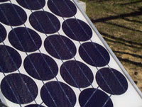
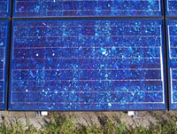
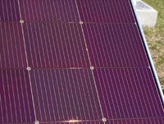
Commercial Solar Cells(CO2)
.
Single crystal silicon
Poly-Crystal Silicon
Thin Films

Slide 38
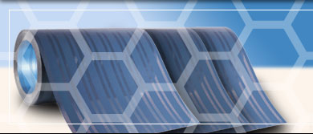
Emerging technologies in solar system(CO2)
Nano-solar techniques:
Nano-Solar – Electrically Conductive Plastics
Konarka – Polymer and dye-sensitized solar cell have flexible cells about 5 % efficient
.

Slide 39
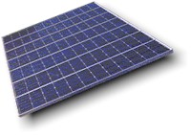
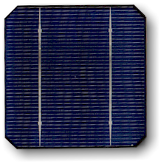

Cells, Modules and Arrays(CO2)
.

Slide 40
Energy Tide-bit(CO2)
The solar cells in the early 1950s were about 0.5 % efficient. Today a module is about 15 % efficient.
A 1 kW system:
In 1950 = 2,400 square feet
In 2005 = 80 Square feet
.

Slide 41
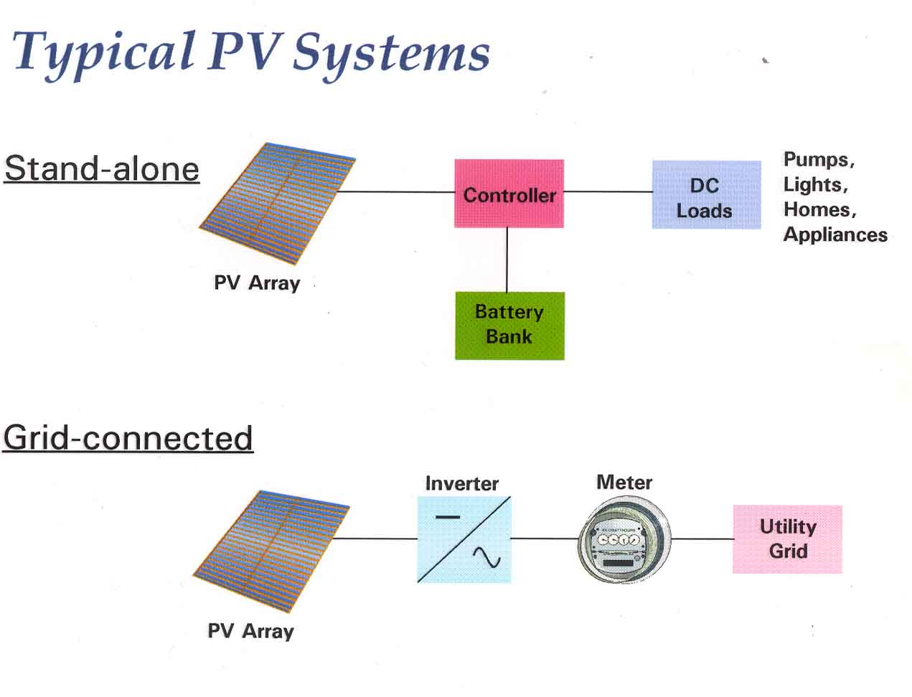
Typical PV systems(CO2)
.
Vikas kumar
(AMTME0113)
11

Slide 42
Solar thermal system(CO2)
Solar thermal systems convert sunlight ( Solar Radiations) to heat.
Categorized by:
FLAT PLATE COLLECTORS
CONCENTRATING COLLECTORS
using lens; regular or Fresnel
Flat mirror (possibly many of them)
Parabolic/cylindrical: single axis forms “trough”
Paraboloidal: axis of revolution forms “dish”
.

Slide 43
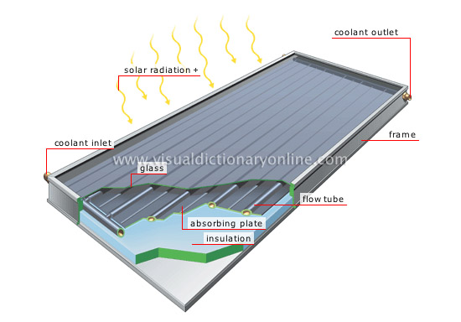
Flat plate collector(CO2)
.

Slide 44
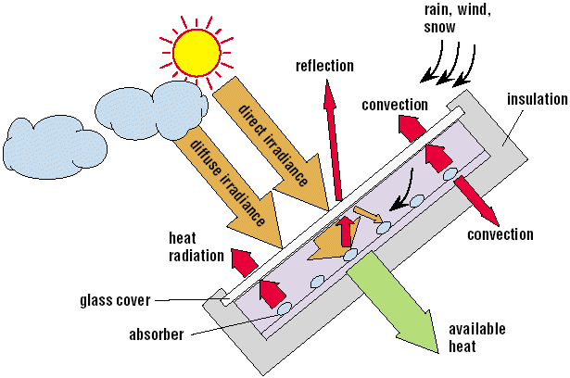
Processes at a flat-plate collector(CO2)
.

Slide 45

Rooftop Heaters(CO2)
Thermo syphon units place the storage tank above the panels, and heated water rises into the tank.
Cooler return water flows from the tank to the bottom of the collectors to enter at the cold end.
No pump is needed to circulate the water.
.
.

Slide 46
Solar Cooker(CO2)
A solar cooker is a device which uses the energy of direct sunlight to heat, cook or pasteurize drink.
Many solar cookers currently in use are relatively inexpensive, low-tech devices, although some are as powerful or as expensive as traditional stoves, and advanced, large-scale solar cookers can cook for hundreds of people.
Because they use no fuel and cost nothing to operate, many non-profit organizations are promoting their use worldwide in order to help reduce fuel costs (especially where monetary reciprocity is low) and air pollution, and to slow down the deforestation and desertification caused by gathering firewood for cooking.
Solar cooking is a form of outdoor cooking and is often used in situations where minimal fuel consumption is important, or the danger of accidental fires is high, and the health and environmental consequences of alternatives are severe.
.

Slide 47
Solar Dryer(CO2)
Solar dryers are devices that use solar energy to dry substances, especially food. There are two general types of solar dryers: Direct and indirect.
Direct solar dryers expose the substance to be dehydrated to direct sunlight. Historically, food and clothing was dried in the sun by using lines, or laying the items on rocks or on top of tents.
In indirect solar dryers, the black surface heats incoming air, rather than directly heating the substance to be dried. This heated air is then passed over the substance to be dried and exits upwards often through a chimney, taking moisture released from the substance with it.

Slide 48

Solar Dryer(CO2)

Slide 49
Domestic hot water and heat system(CO2)
Water heating is a thermodynamic process that uses an energy source to heat water above its initial temperature.
Typical domestic uses of hot water include cooking, cleaning, bathing, and space heating.
In industry, hot water and water heated to steam have many uses.
Domestically, water is traditionally heated in vessels known as water heaters, kettles, cauldrons, pots, or coppers.
These metal vessels that heat a batch of water do not produce a continual supply of heated water at a preset temperature.
Hot water occurs naturally, usually from natural hot springs. The temperature varies with the consumption rate, becoming cooler as flow increases.
.

Slide 50

A thermo syphon system(CO2)
.

Slide 51

A solar district heating system(CO2)
.

Slide 52
Concentrating Collectors(CO2)
Axicon Conical Reflector
Parabolic Trough
Paraboloidal Dish
Solar Power Tower
.

Slide 53
Axicon conical reflector(CO2)
.
A polished mirror cone reflects the sun onto a water-filled pipe and can boil the water
The surface of polished metal or foil is cheap to make and form
First used in the 1800s

Slide 54

Solar Focusing Systems: Parabolic(CO2)
.
Focuses parallel rays to a line
A black pipe is placed with its center at the focus
Pipe can be in a vacuum or could have a glass cover tube to reduce convection
Cylindrical reflector can be on one half of the vacuum tube and approximates the parabolic shape

Slide 55

Solar Focusing Systems: Paraboloidal(CO2)
.
The focus at one spot is achieved by the parabolic cross-section
Flat mirror segments may be used to approximate the curve at much lower expense

Slide 56
Solar Power Towers(CO2)
Solar power towers were developed using Heliostats (Heliostatic mirrors) to focus sunlight at central receiver tower.
The heliostat mirrors are about ten feet square and mounted on the azimuth-elevation mounts (like a radar antenna mount) about 10 feet off the ground.
Normally water is used to produce steam, but the system is being modified for molten salt.
.

Slide 57

Solar Power Towers(CO2)
.

Slide 58
Advantages & Disadvantages of solar thermal system(CO2)
.
Solar thermal systems work efficiently at lower temperatures since cheap flat collectors can work economically
Reflecting systems need broad acceptance angles so that the optics don’t cost too much
The beam need only strike the absorber, not form a picture image (noncoherent)
Reflectors must be kept clean by frequent washing
Reflectors wouldn’t be wise in hailstorm country!
Could be protected by a quickly erected tarp

Slide 59

Methods For Storing Solar Thermal Energy
.

Slide 60

Solar Power Plant (CO2)
.

Slide 61


Solar Power Plant (CO2)
.

Slide 62
SOLAR PONDS(CO2)
Normal ponds receive sunlight a part of which is reflected at the surface, a part is absorbed and the remaining is transmitted to the bottom.
Due to this the lower part gets heated up and the density decreases as a result of which it rises up and convection currents are set up.(As a result, the heated water reaches top layer and looses its heat by convection and evaporation).
A natural or artificial body of water for collecting and absorbing solar radiation energy and storing it as heat.
Thus a solar pond combines solar energy collection and sensible heat storage.
They are large shallow bodies of water that are arranged so that the temperature gradient are reversed from the normal.
This allows the use for collection and storage of solar energy which may under ideal conditions be delivered at temperature 40-50 `C above normal.
It can be use for various applications, such as process heating, water desalination, refrigeration, drying and power generation.
.

Slide 63

SOLAR PONDS(CO2)
.

Slide 64

FACULTY VIDEO LINKS, YOUTUBE & NPTEL VIDEO LINKS AND ONLINE COURSES DETAILS
Youtube /other Video Links
https://www.youtube.com/watch?v=m6UgO6-HELc
https://www.youtube.com/watch?v=2-I4jC7CoBc
https://www.youtube.com/watch?v=od5yWB5aE0c
https://www.youtube.com/watch?v=_wCG1zB8-ms
50

Slide 65



DAILY QUIZ
Which of the following is true about solar energy?
It is becoming cheaper to produce electricity
Solar energy can currently replace all of the energy created by fossil fuels
Most solar panels convert more than 25% of the light that strikes them
None of the above
2. Solar power is considered a renewable energy source.
True
false

Slide 66
DAILY QUIZ
3. Solar power can be used to generate heat or ________
Heat
Electricity
Sunlight
Cold
4. Which of the following is another name for solar cells?
Active cells
PV cells
Voltage cells
Passive cells

Slide 67
DAILY QUIZ
5. Which of the following is a drawback to using solar cells to produce electricity?
Cost of the cells
It takes a lot of cells to produce energy
It is dependent on the weather
All of the above
6. Solar energy is a __________ energy resource.
Renewable
Nonrenewable

Slide 68
GLOSSARY QUESTIONS
Kindly choose answer from following Glossary:
Renewable source of Energy
Non renewable source of Energy
None
QUESTIONS
Q. 01. solar is,
Q. 02 wind is,
Q. 03. water is,

Slide 69
WEEKLY ASSIGNMENT
How do solar panels actually work?
Is solar energy reliable and powerful enough for home or business?
How does solar energy benefit the environment?
What is photovoltaic (solar electricity) or "PV"?
How can we get electricity from the sun?
What are the components of a photovoltaic (PV) system?
What's the difference between PV and other solar energy technologies?
How does a solar water-heating system work?

Slide 70

MCQ
1-Direct Solar energy is used for
(A) Water heating
(B) Distillation
(C) Drying
(D) All of the above
2-The power from the sun intercepted by the earth is approximately
(A) 1.8 x 10⁸ MW
(B) 1.8 x 10¹¹ MW
(C) 1.8 x 10¹⁴ MW
(D) 1.8 x 10¹⁷ MW
3-The following is indirect method of Solar energy utilization
(A) Wind energy
(B) Biomass energy
(C) Wave energy
(D) All of the above

Slide 71
MCQ
4-The efficiency of various types of collectors __with __temperature.
(A) increases, decreasing
(B) decreases, increasing
(C) remains same, increasing
(D) depends upon type of collector
5-Maximum efficiency is obtained in
(A) Flat plate collector
(B) Evacuated tube collector
(C) Line focussing collector
(D) Paraboloid dish collector
6-The following type of energy is stored as latent heat
(A) Thermal energy
(B) Chemical energy
(C) Electrical energy
(D) Mechanical energy

Slide 72

OLD QUESTION PAPER

Slide 73
OLD QUESTION PAPER

Slide 74
References
Energy Efficient Buildings in India Mili Majumdar Tata Energy Research Institute
Understanding Renewable Energy Systems Volker Quaschning
Renewable Energy Systems Simmoes Marcelo Godoy CRC Press
Renewable Energy Resources John Twidell Taylor and Francis
Renewable Energy Sources and Their Environmental Impact Abbasi & Abbasi Prentice Hall of India

Slide 75
NOIDA INSTITUTE OF ENGINEERING AND TECHNOLOGY
Thank you

